Slide 1
Functions

Slide 2
Definition of Functions
Given any sets A, B, a function f from (or “mapping”) A to B (f:A→B) is an assignment of exactly one element f(x)∈B
to each element x∈A.

Slide 3
Graphical Representations
Functions can be represented graphically in several ways:
f
A
B
•
•
f
•
•
•
•
•
y
a
b
•
•
•
•
x
A
B
Graph
Plot
Like Venn diagrams

Slide 4
Definition of Functions (cont’d)
Formally: given f:A→B
“x is a function” :≡ (¬∃x,y: x=y ∧ f(x) ≠ f(y)) or
“x is a function” :≡ (∀ x,y: ¬(x=y) ∨ ¬(f(x) ≠ f(y))) or
“x is a function” :≡ (∀ x,y: ¬(x=y) ∨ (f(x) = f(y))) or
“x is a function” :≡ (∀ x,y: (x=y) → (f(x) = f(y))) or
“x is a function” :≡ (∀ x,y: (f(x) ≠ f(y)) → (x ≠ y))

Slide 5
Some Function Terminology
If f:A→B, and f(a)=b (where a∈A & b∈B), then:
  A is the domain of f.
  B is the codomain of f.
  b is the image of a under f.
  a is a pre-image of b under f.
    In general, b may have more than one pre-image.
  The range R⊆B of f is {b | ∃a f(a)=b }.

Slide 6
Range vs. Codomain - Example
Suppose that: “f is a function mapping students in this class to the set of grades {A,B,C,D,E}.”
At this point, you know f’s codomain is: __________, and its range is ________.
Suppose the grades turn out all As and Bs.
Then the range of f is _________, but its codomain is __________________.
{A,B,C,D,E}
unknown!
{A,B}
still {A,B,C,D,E}!

Slide 7
Function Addition/Multiplication
We can add and multiply functions
f,g:R→R:
  (f + g):R→R, where (f + g)(x) = f(x) + g(x)
  (f × g):R→R, where (f × g)(x) = f(x) × g(x)

Slide 8
Function Composition
For functions g:A→B and f:B→C, there is a special operator called compose (“○”).
  It composes (i.e., creates) a new function out of f,g by applying f to the result of g.
  (f○g):A→C, where (f○g)(a) = f(g(a)).
  Note g(a)∈B, so f(g(a)) is defined and ∈C.
  The range of g must be a subset of f’s domain!!
  Note that ○ (like Cartesian ×, but unlike +,∧,∪) is non-commuting. (In general, f○g ≠ g○f.)

Slide 9
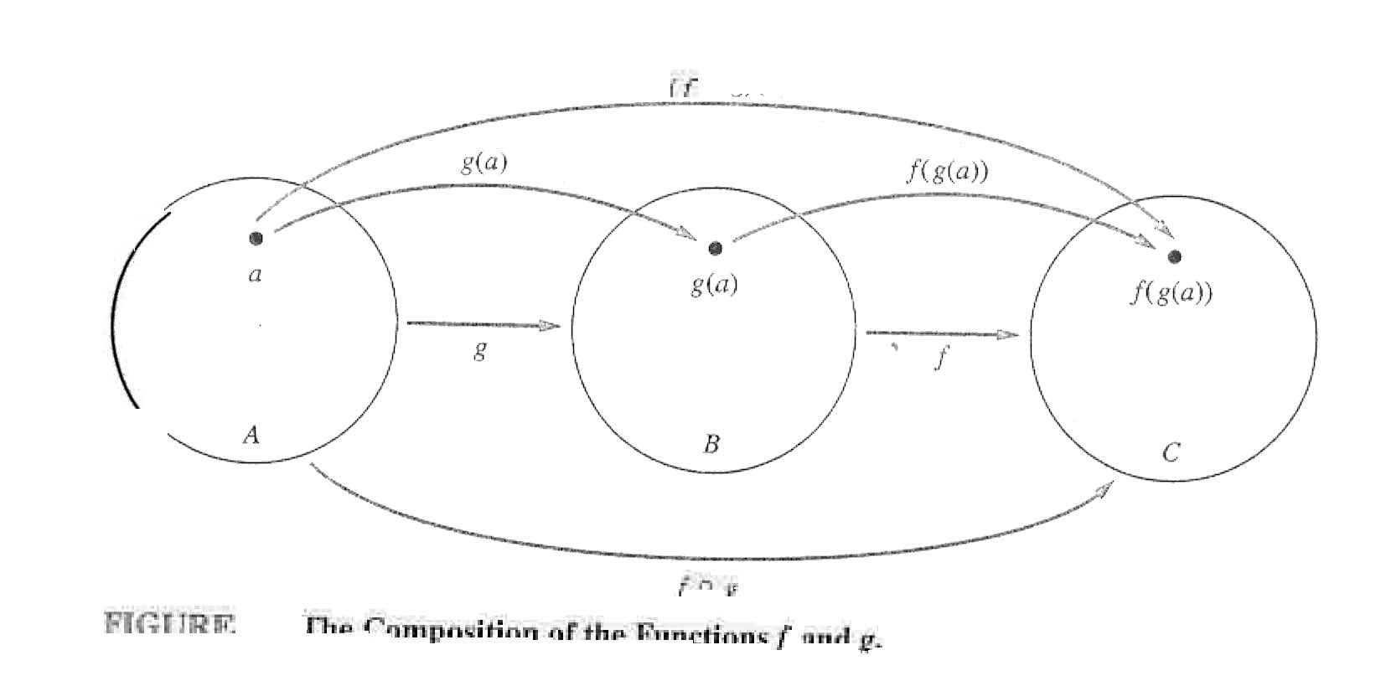
Function Composition

Slide 10
Images of Sets under Functions
Given f:A→B, and S⊆A,
The image of S under f is simply the set of all images (under f) of the elements of S.
f(S) :≡ {f(s) | s∈S}
:≡ {b | ∃ s∈S: f(s)=b}.
Note the range of f can be defined as simply the image (under f) of f’s domain!

Slide 11
One-to-One Functions
A function is one-to-one (1-1), or injective, or an injection, iff every element of its range has only one pre-image.
Only one element of the domain is mapped to any given one element of the range.
  Domain & range have same cardinality. What about codomain?
May Be
Larger

Slide 12
One-to-One Functions (cont’d)
Formally: given f:A→B
“x is injective” :≡ (¬∃x,y: x≠y ∧ f(x)=f(y)) or
“x is injective” :≡ (∀ x,y: ¬(x≠y) ∨ ¬(f(x)=f(y))) or
“x is injective” :≡ (∀ x,y: ¬(x≠y) ∨ (f(x) ≠ f(y))) or
“x is injective” :≡ (∀ x,y: (x≠y) → (f(x) ≠ f(y))) or
“x is injective” :≡ (∀ x,y: (f(x)=f(y)) → (x =y))

Slide 13
One-to-One Illustration
Graph representations of functions that are (or not) one-to-one:
•
•
•
•
•
•
•
•
•
•
•
•
•
•
•
•
•
•
•
•
•
•
•
•
•
•
•
Not one-to-one
Not even a
function!
One-to-one

Slide 14
Sufficient Conditions for 1-1ness
Definitions (for functions f over numbers):
  f is strictly (or monotonically) increasing iff x>y → f(x)>f(y) for all x,y in domain;
  f is strictly (or monotonically) decreasing iff x>y → f(x)<f(y) for all x,y in domain;
If f is either strictly increasing or strictly decreasing, then f is one-to-one.
  e.g. f(x)=x³

Slide 15
Onto (Surjective) Functions
A function f:A→B is onto or surjective or a surjection iff its range is equal to its codomain (∀b∈B, ∃a∈A: f(a)=b).
An onto function maps the set A onto (over, covering) the entirety of the set B, not just over a piece of it.
  e.g., for domain & codomain R, x³ is onto, whereas x² isn’t. (Why not?)

Slide 16
Illustration of Onto
Some functions that are or are not onto their codomains:
•
•
•
•
•
•
•
•
•
•
•
•
•
•
•
•
•
•
•
•
•
•
•
•
•
•
•
•
•
•
•
•
•
•
•
Onto
(but not 1-1)
Not Onto
(or 1-1)
Both 1-1
and onto
1-1 but
not onto

Slide 17
Bijections
A function f is a one-to-one correspondence, or a bijection, or reversible, or invertible, iff it is both one-to-one and onto.

Slide 18
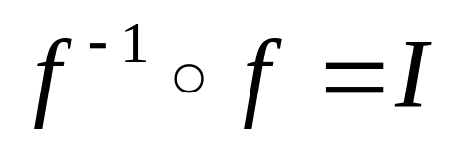
Inverse of a Function
For bijections f:A→B, there exists an inverse of f, written f ⁻¹:B→A, which is the unique function such that:

Slide 19
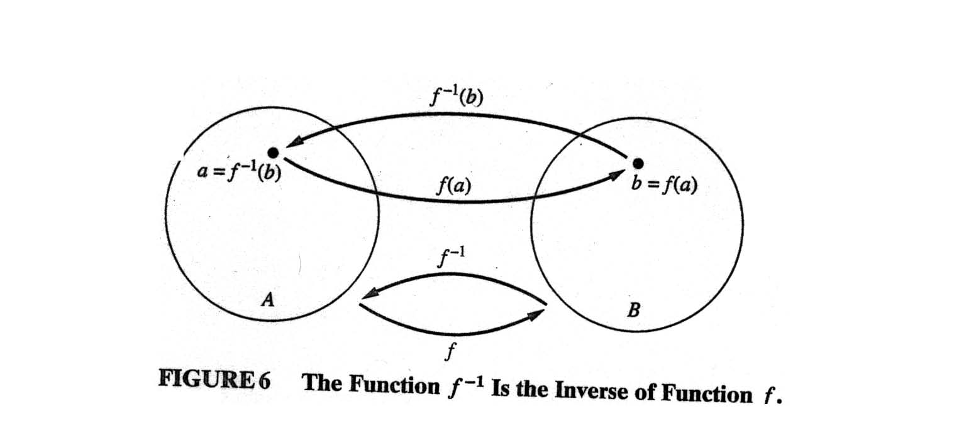
Inverse of a function (cont’d)

Slide 20
The Identity Function
For any domain A, the identity function I:A→A (variously written, I_{A}, 1, 1_{A}) is the unique function such that ∀a∈A: I(a)=a.
Some identity functions you’ve seen:
  ∧ing with T, ∨ing with F, ∪ing with ∅, ∩ing with U.
Note that the identity function is both one-to-one and onto (bijective).

Slide 21
Identity Function Illustrations
The identity function:
•
•
•
y
•
•
•
•
•
•
Domain and range
x

Slide 22
Graphs of Functions
We can represent a function f:A→B as a set of ordered pairs {(a,f(a)) | a∈A}.
Note that ∀a, there is only one pair (a, f(a)).
For functions over numbers, we can represent an ordered pair (x,y) as a point on a plane. A function is then drawn as a curve (set of points) with only one y for each x.

Slide 23
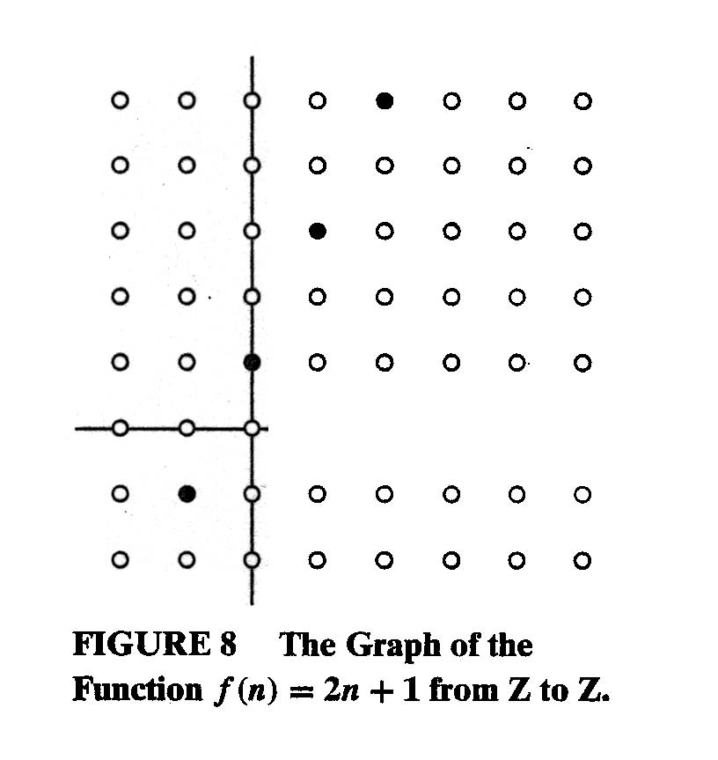
Graphs of Functions

Slide 24
A Couple of Key Functions
In discrete math, we frequently use the following functions over real numbers:
  ⎣x⎦ (“floor of x”) is the largest integer ≤ x.
  ⎡x⎤ (“ceiling of x”) is the smallest integer ≥ x.

Slide 25
Visualizing Floor & Ceiling
Real numbers “fall to their floor” or “rise to their ceiling.”
Note that if x∉Z,
⎣−x⎦ ≠ − ⎣x⎦ &
⎡−x⎤ ≠ − ⎡x⎤
Note that if x∈Z,
⎣x⎦ = ⎡x⎤ = x.
3
.
2
⎡1.6⎤=2
.
1.6
.
1
⎣1.6⎦=1
0
.
−1
⎡−1.4⎤= −1
.
−1.4
.
−2
.
.
.
⎣−1.4⎦= −2
−3
−3
⎡−3⎤=⎣−3⎦= −3

Slide 26
Plots with floor/ceiling: Example
Plot of graph of function f(x) = ⎣x/3⎦:
f(x)
Set of points (x, f(x))
+2
−3
+3
x
−2

